Slide 1
BIRCH:
An Efficient Data Clustering Method for Very Large Databases
Tian Zhang, Raghu Ramakrishnan, Miron Livny
ACM SIGMOD 1996

Slide 2
Problem Introduction
Data clustering
  How do we divide n data points into k groups?
    How do we minimize the difference within the groups?
    How do we maximize the difference between different groups?
  How do we avoid trying all possible solutions?
Very large data sets
Limited computational resources
Notes:
The "difference" between groups could be something like the sum of squared distances from the cluster centers
Except when n and k are small you can not try all solutions

Slide 3
Outline
Problem introduction
Previous work
Introduction to BIRCH
The algorithm
Experimental results
Conclusions & practical use

Slide 4
Previous Work
Unsupervised conceptual learning
Two classes of clustering algorithms:
  Probability-Based
    COBWEB and CLASSIT
  Distance-Based
    KMEANS, KMEDOIDS and CLARANS

Slide 5
Previous work: COBWEB
Probabilistic approach to make decisions
  Probabilistic measure: Category Utility
  Clusters are represented with probabilistic description
Incrementally generates a hierarchy
  Cluster data points one at a time
  Maximizes Category Utility at each decision point
Notes:
COBWEB descent has 4 choices:
1) recursively incorporating into existing node
2) new node for instance
3) merging two nodes
4) splitting a node
COBWEB vs. CLASSIT
discrete/continuous
stores discrete probabilities/continuous probabilities
always descends to a terminal node/can stop at similar nodes
Iterative algorithms are input order sensitive!

Slide 6
Previous work: COBWEB
Computing category utility is very expensive
  Attributes are assumed to be statistically independent
Only works with discrete values
  CLASSIT is similar, but is adapted to only handle continuous data
Every instance translates into a terminal node in the hierarchy
  Infeasible for large data sets
  Large hierarchies tend to over fit data

Slide 7
Previous work: KMEANS
Distance based approach
  There must be a distance measurement between any two instances (data points)
Iteratively groups instances towards the nearest centroid to minimize distances
Converges on a local minimum
  Sensitive to instance order
May have exponential run time (worst case)

Slide 8
Previous work: KMEANS
Some assumptions:
  All instances must be initially available
  Instances must be stored in memory
  Frequent scan (non-incremental)
Global methods at the granularity of data points
  All instances are considered individually
  Not all data are equally important for clustering
  Close or dense ones could be considered collectively!

Slide 9
Introduction to BIRCH
BIRCH: Balanced Iterative Reducing and Clustering using Hierarchies
Only works with "metric" attributes
  Must have Euclidean coordinates
Designed for very large data sets
  Time and memory constraints are explicit
  Treats dense regions of data points as sub-clusters
    Not all data points are important for clustering
  Only one scan of data is necessary

Slide 10
Introduction to BIRCH
Incremental, distance-based approach
  Decisions are made without scanning all data points, or all currently existing clusters
  Does not need the whole data set in advance
  Unique approach: Distance-based algorithms generally need all the data points to work
Make best use of available memory while minimizing I/O costs
Does not assume that the probability distributions on attributes is independent

Slide 11



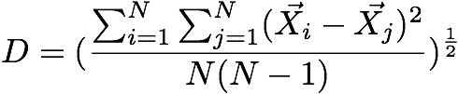
Background
Given a cluster of instances , we define:
Centroid:
Radius: average distance from member points to centroid
Diameter: average pair-wise distance within a cluster
Notes:
These are properties of a SINGLE cluster
The centroid is the center of the cluster
The radius is average distance of each instance to the centroid
The diameter is the average distance between any two instances
LIMITATION: clusters must be round! (from textbook)

Slide 12

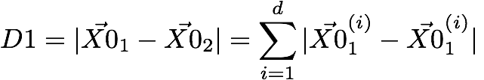
Background
We define the centroid Euclidean distance and centroid Manhattan distance between any two clusters as:
Notes:
These are properties of TWO clusters
The first cluster is X_1, X_2, ... , X_N
The second cluster is X_(N+1), X_(N+2), ... , X_(N+N_2)
D0 is Euclidean distance
D1 is Manhattan distance

Slide 13

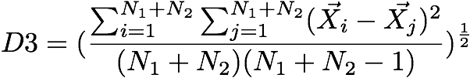
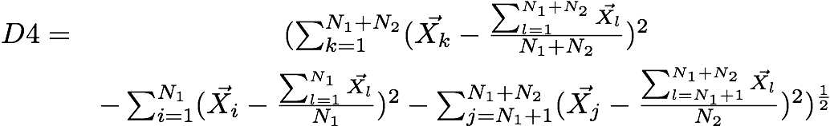
Background
We define the average inter-cluster, the average intra-cluster, and the variance increase distances as:

Slide 14
Background
Cluster {X_{i}}:
i = 1, 2, …, N₁
Cluster {X_{j}}:
j = N₁+1, N₁+2, …, N₁+N₂

Slide 15
Background
Cluster X_{l} = {X_{i}} + {X_{j}}:
l = 1, 2, …, N₁, N₁+1, N₁+2, …, N₁+N₂

Slide 16
Background
Optional Data Preprocessing (Normalization)
  Can not affect relative placement
    If point A is left of B, then after pre-processing A must still be to the left of B
  Avoids bias caused by dimensions with a large spread
  Large spread may naturally describe data!

Slide 17

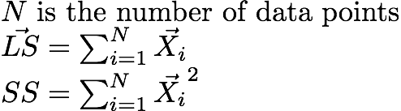
Clustering Feature
A Clustering Feature (CF) summarizes a sub-cluster of data points:
Notes:
N is the number of data points
LS is the linear sum of the N points
SS is the square sum of the N points
CF Additivity Theorem: if CF_1 and CF_2 are disjoint, merging them is equal to the sum of their parts

Slide 18
Properties of Clustering Feature
CF entry is more compact
  Stores significantly less then all of the data points in the sub-cluster
A CF entry has sufficient information to calculate D0-D4
Additivity theorem allows us to merge sub-clusters incrementally & consistently

Slide 19
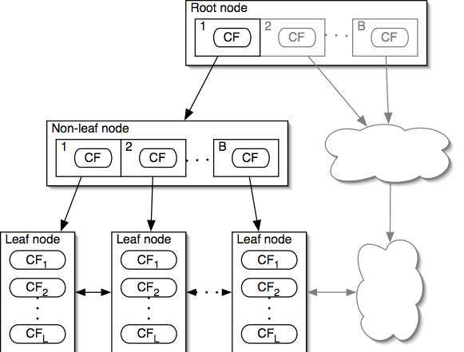
CF-Tree
Notes:
The grey area is an arbitrary HEIGHT BALANCED continuation of the tree example
EVERY CF IS A SUB-CLUSTER!
Non-leaf nodes contain at most B entries
Each entry is a pointer to another node and CF for that node
The entire node makes up a sub-cluster made up of all of the sub-clusters represented by the entries
Leaf nodes contain at most L entries
Each entry is a CF
The entire node makes up a sub-cluster made up of all the sub-clusters represented by the entries

Slide 20
Properties of CF-Tree
Each non-leaf node has at most B entries
Each leaf node has at most L CF entries which each satisfy threshold T
Node size is determined by dimensionality of data space and input parameter P (page size)
Notes:
A non-leaf node entry is a CF tuple and a child node link
A leaf node is a collection of CF tuples and links to the next and previous leaf nodes
T is maximum diameter (or radius) of any CF in a leaf node
CFs "absorb" data points close to them
BALANCED HEIGHT!

Slide 21
CF-Tree Insertion
Recurse down from root, find the appropriate leaf
  Follow the "closest"-CF path, w.r.t. D0 / … / D4
Modify the leaf
  If the closest-CF leaf cannot absorb, make a new CF entry. If there is no room for new leaf, split the parent node
Traverse back & up
  Updating CFs on the path or splitting nodes
Notes:
Closest CF is determined by any of D0-D4
Leaf node split: take two farthest CFs and create two leaf nodes, put the remaining CFs (including the new one that caused the split) into the closest node (which seed CF is closer?).
Splitting the root on the traverse back up increases tree height by one
Refinement: when traversing back up, stop at the first node that does not need to split; find the two closest CFs in the node; if they are not the nodes just created by the previous split try merging them into one node. This refinement often frees extra space by reducing the number of nodes needed

Slide 22
CF-Tree Rebuilding
If we run out of space, increase threshold T
  By increasing the threshold, CFs absorb more data
  Goal: Keep CF tree in main memory
Rebuilding "pushes" CFs over
  The larger T allows different CFs to group together
Reducibility theorem
  Increasing T will result in a CF-tree as small or smaller then the original
  Rebuilding needs at most “h” extra pages of memory
Notes:
Bigger T = Smaller CF-tree
The rebuild will also take no more then h (height of the original tree) extra pages of memory (nodes)

Slide 23
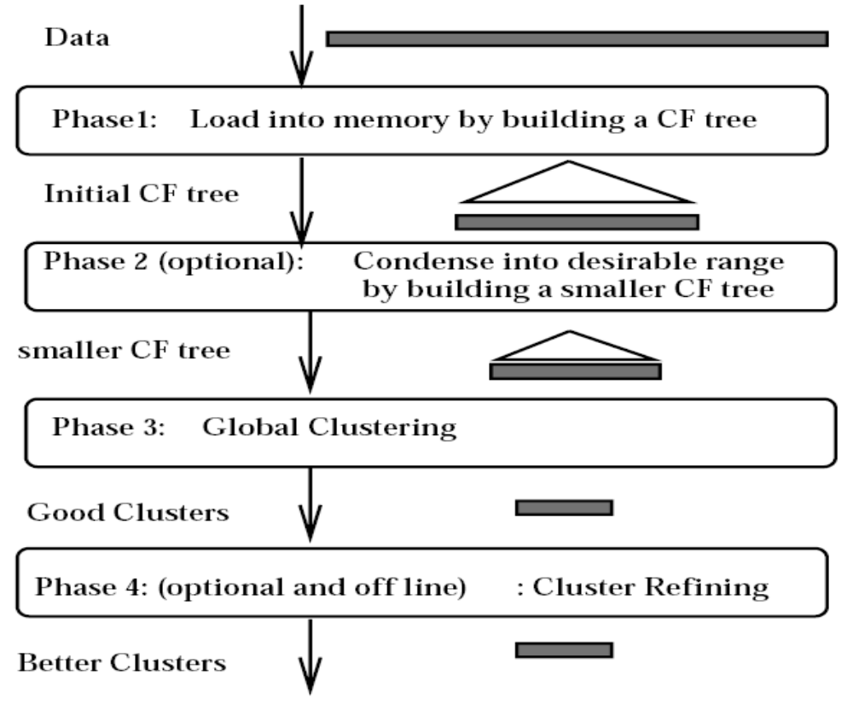
BIRCH Overview

Slide 24
The Algorithm: BIRCH
Phase 1: Load data into memory
  Build an initial in-memory CF-tree with the data (one scan)
  Subsequent phases become fast, accurate, less order sensitive
Phase 2: Condense data
  Rebuild the CF-tree with a larger T
  Condensing is optional
Notes:
Example for condensing data:
CLARANS works well with under 5000 data objects, use phase 2 as a bridge from larger data sets down to more reasonable size.

Slide 25
The Algorithm: BIRCH
Phase 3: Global clustering
  Use existing clustering algorithm on CF entries
  Helps fix problem where natural clusters span nodes
Phase 4: Cluster refining
  Do additional passes over the dataset & reassign data points to the closest centroid from phase 3
  Refining is optional
Notes:
Refining detail:
Get centroid of each cluster from phase 3; scan the data clustering each data object with the closest centroid; repeat with new cluster centroids
Refining is optional, however by passing over the data set we get the opportunity to label each data object with the appropriate cluster
Repeat phase 4 as many times as you want, eventually it converges (two runs through the data return the exact same results.

Slide 26
The Algorithm: BIRCH
Why have optional phases?
  Phase 2 allows us to resize the data set so Phase 3 runs on an optimally sized data set
  Phase 4 fixes a problem with CF-trees where some data points may be assigned to different leaf entries
  Phase 4 will always converge to a minimum
  Phase 4 allows us to discard outliers

Slide 27
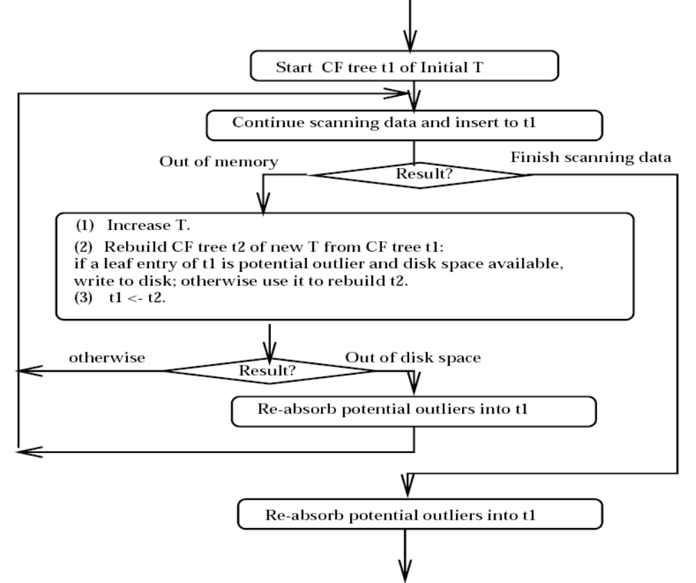
The Algorithm: BIRCH

Slide 28
The Algorithm: BIRCH
Rebuild CF-tree with smallest T
  Start with T = 0 and try rebuilding the tree
Get rid of outliers
  Write outliers to special place outside of the tree
Delayed split
  Treat data points that force a split like outliers
Notes:
WAYS TO OPTIMIZE PHASE 1
With T=0, you get the biggest tree possible: each data point is it's own entry in a leaf node. On large data sets this will fail very quickly. Increase T and try again.
Writing the outliers to memory outside the tree wastes good memory, if we have written outliers and we run out of memory, try inserting the outliers to reclaim memory.
Delayed split: sometimes a tree doesn't need to be split, so write the data point to memory, and try the next one until you run out of disk space of nodes to check. Then go through and insert the splitting nodes.

Slide 29
Experimental Results
Input parameters:
  Memory (M): 5% of data set
  Disk space (R): 20% of M
  Distance equation: D2
  Quality equation: weighted average diameter (D)
  Initial threshold (T): 0.0
  Page size (P): 1024 bytes

Slide 30
Experimental Results
The Phase 3 algorithm
  An agglomerative Hierarchical Clustering (HC) algorithm
One refinement pass
  Outlier discarding is off
Delay-split is on
  This is what we use disk space R for
Notes:
agglomerative HC is from Clark F. Olson, Parallel Algorithms for Hierarchical Clustering

Slide 31
Experimental Results
Create 3 synthetic data sets for testing
  Also create an ordered copy for testing input order
KMEANS and CLARANS require entire data set to be in memory
  Initial scan is from disk, subsequent scans are in memory

Slide 32
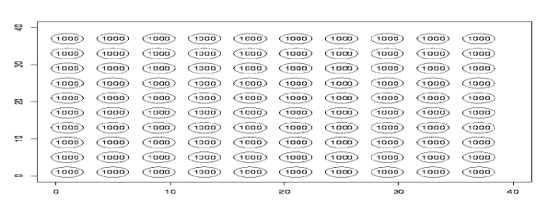
Experimental Results
Intended clustering

Slide 33
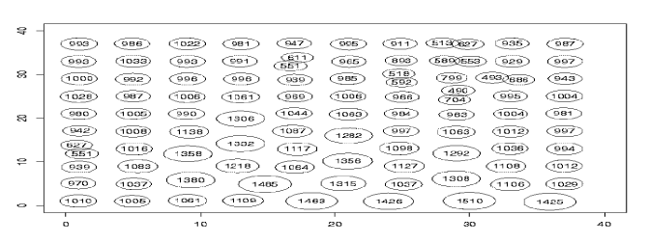
Experimental Results
KMEANS clustering
DS | Time | D | # Scan | DS | Time | D | # Scan
1 | 43.9 | 2.09 | 289 | 1o | 33.8 | 1.97 | 197
2 | 13.2 | 4.43 | 51 | 2o | 12.7 | 4.20 | 29
3 | 32.9 | 3.66 | 187 | 3o | 36.0 | 4.35 | 241

Slide 34
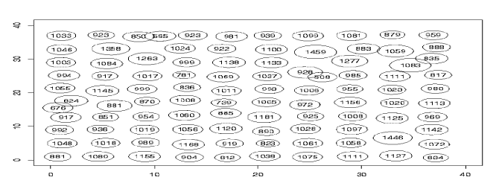
Experimental Results
CLARANS clustering
DS | Time | D | # Scan | DS | Time | D | # Scan
1 | 932 | 2.10 | 3307 | 1o | 794 | 2.11 | 2854
2 | 758 | 2.63 | 2661 | 2o | 816 | 2.31 | 2933
3 | 835 | 3.39 | 2959 | 3o | 924 | 3.28 | 3369

Slide 35
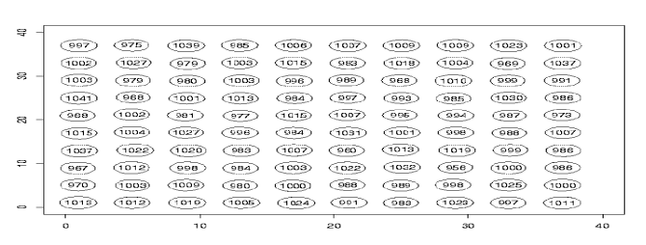
Experimental Results
BIRCH clustering
DS | Time | D | # Scan | DS | Time | D | # Scan
1 | 11.5 | 1.87 | 2 | 1o | 13.6 | 1.87 | 2
2 | 10.7 | 1.99 | 2 | 2o | 12.1 | 1.99 | 2
3 | 11.4 | 3.95 | 2 | 3o | 12.2 | 3.99 | 2

Slide 36
Experimental Results
Page size
  When using Phase 4, P can vary from 256 to 4096 without much effect on the final results
Memory vs. Time
  Results generated with low memory can be compensated for by multiple iterations of Phase 4
Scalability
Notes:
Scalability:
Number of points per cluster (n)
Number of clusters (K)
Dimension of data points (d)

Slide 37
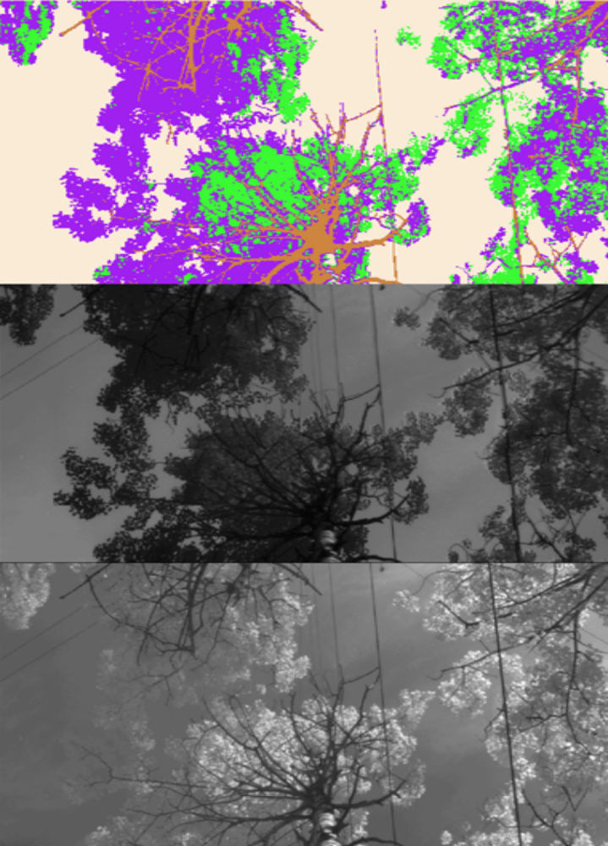
Conclusions & Practical Use
Pixel classification in images
From top to bottom:
  BIRCH classification
  Visible wavelength band
  Near-infrared band
Notes:
BIRCH is used to classify sky, branches, shadows and sunlit leaves

Slide 38
Conclusions & Practical Use
Image compression using vector quantization
  Generate codebook for frequently occurring patterns
  BIRCH performs faster then CLARANS or LBG, while getting better compression and nearly as good quality

Slide 39
Conclusions & Practical Use
BIRCH works with very large data sets
Explicitly bounded by computational resources
  Runs with specified amount of memory (P)
Superior to CLARANS and KMEANS
  Quality, speed, stability and scalability
Notes:
O(n) runtime! Good for very large data sets when time or memory is constrained

